Slide 1
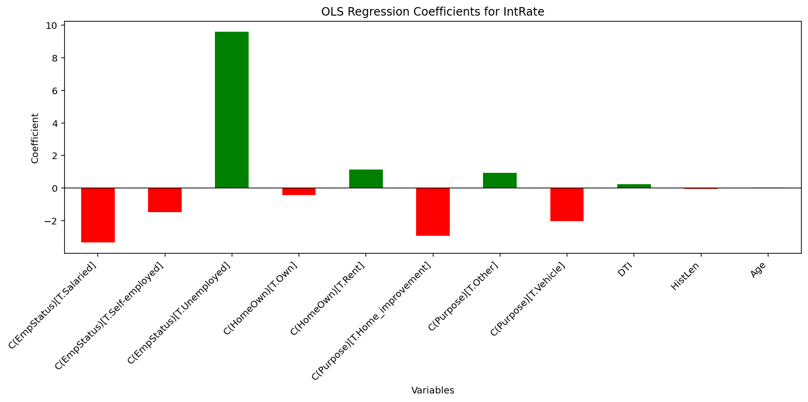
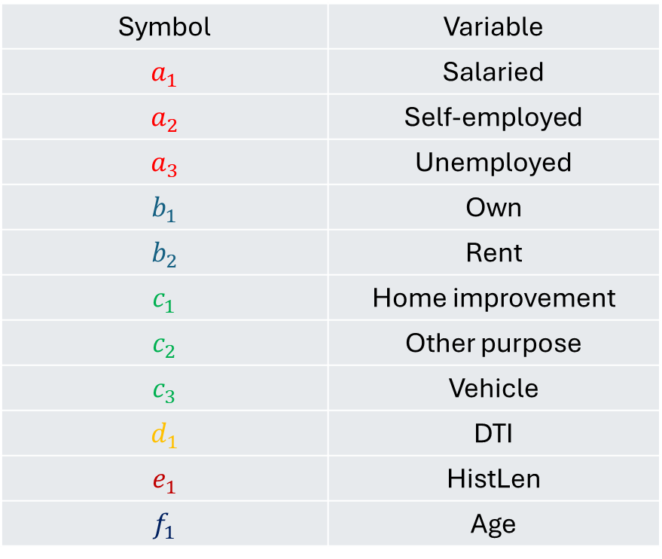
6. How the model will look
Y = $22.6789−3.3470a_{1}−1.4672a_{2}+9.5922a_{3}$ $−0.4335b_{1}+1.1305b_{2}$ $−2.9393c_{1}+0.9234c_{2}−2.0303c_{3}+0.2310d_{1}−0.0507e_{1}+0.0315f_{1}$
Symbol | Variable
$$a_{1}$$ | Salaried
$$a_{2}$$ | Self-employed
$$a_{3}$$ | Unemployed
$$b_{1}$$ | Own
$$b_{2}$$ | Rent
$$c_{1}$$ | Home improvement
$$c_{2}$$ | Other purpose
$$c_{3}$$ | Vehicle
$$d_{1}$$ | DTI
$$e_{1}$$ | HistLen
$$f_{1}$$ | Age

Slide 2
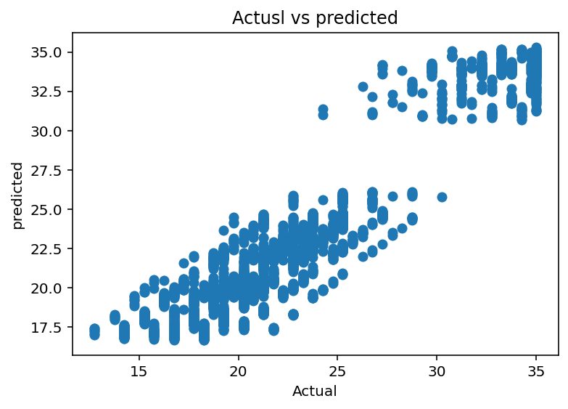
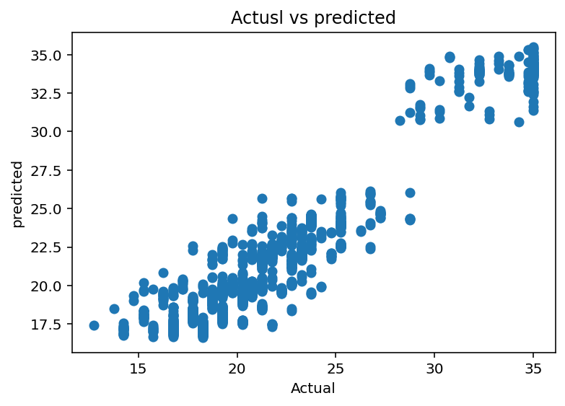
Train data
3
91.8%
91.8%
8,004
R-squared
Adjusted R-squared
Observations
≈ 1.043
7.12
8,183
Previously reported average error
Previously reported maximum error
F-statistic
2. Overall model fit of our data
Test data
91.7%
91.7%
2,001
R-squared
Adjusted R-squared
Observations
≈ 1.04
4.94
2004
Previously reported average error
Previously reported maximum error
F-statistic

